Slide 1
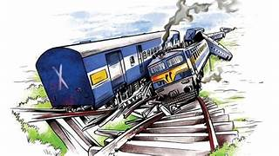
TRAIN ACCIDENT PREVENTION
Internal guide :
MRS. Uma Rani
Team Mates :
M. Maneesh – 20AG1A6933
M. Poojitha – 20AG1A6935
N. Vijay Kumar – 20AG1A6945
P. Santhosh – 20AG1A6950

Slide 2
AGENDA :
Introduction
Abstract
Existing System
Disadvantage of Existing System
Proposed system
Advantage of Proposed System
Hardware Components
Software Components
Literature survey
System Architecture
Circuit Diagram
Block Diagram
UML Diagram
Flow chart
Implementation of Objective 1
Conclusion

Slide 3
INTRODUCTION :
Train transport is a means of transport that transfer passengers and goods on wheeled vehicles running on rails, which are incorporated in tracks.
In contrast to road transport, where the vehicles run on prepared flat surface, rail vehicles are directionally guided by the tracks on which they run.
Trains are used to carry people, and also things like raw material, finished goods, cargo, and waste.
Advantages of trains : Eco-Friendly travelling , Affordability.

Slide 4
ABSTRACT :
Railway crossings are one of the most dangerous areas for both road vehicles as well as pedestrians.
According to statistics, approximately 61% of all railway accidents occur at crossings. This is a significant concern that needs to be aware of.
The automatic railway gate control system using an Arduino and infrared sensor is a simple yet effective solution to this problem.
The system uses an Arduino microcontroller and infrared sensors to detect the approaching train and automatically close the gates to prevent any accidents.

Slide 5
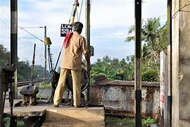
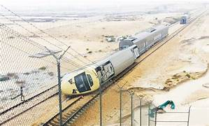
EXISTING SYSTEM :
Manual lifting railway gates, also known as level crossing gates or broom barriers, are operated by railways staff or gatekeepers to control the passage of vehicles and pedestrians across railway track. Here’s hoe they typically work :
Detection of Train Approach
Closing the gates
Ensuring Safety
It’s important to note that manual lifting railway gates rely heavily on the presence and actions of the gatekeepers.
Train operations during rainy conditions can be more challenging and potentially riskier due to reduced visibility, slippery tracks, and other rain- related factors. This causes train accidents

Slide 6
DISADVANTAGES :
Manual lifting railway gates, while serving their purpose, have several disadvantages:
Human Error: Manual operation relies on gatekeepers to raise and lower the gates at the right times. Human error, such as forgetting to close the gate or mistiming the opening, can lead to accidents.
Response Time: Gatekeepers might not always be able to respond quickly to approaching trains, especially in situations where multiple trains are coming from different directions simultaneously.
Labor Intensive: Manual operation requires dedicated gatekeepers at each level crossing, which can be labor-intensive and expensive to maintain, especially in remote or less populated areas.
Limited Visibility: Gatekeepers might have limited visibility of the tracks, making it harder for them to judge the speed and distance of oncoming trains accurately.

Slide 7
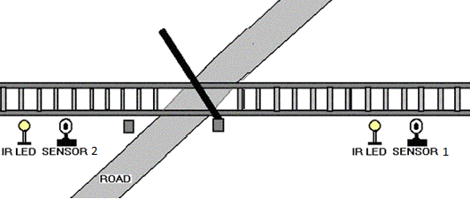
PROPOSED SYSTEM :
To prevent train accidents we use automatic railway gates.
Practically, the two IR sensors are placed at left and right side of the railway gate. The distance between the two IR sensors is dependent on the length of the train. In general we have to consider the longest train in that route.
Now we’ll see how this circuit actually works in real time. In this image, we can see the real time representation of this project.
If the sensor 1 detects the arrival of the train, microcontroller starts the motor with the help of motor driver in order to close the gate.

Slide 8
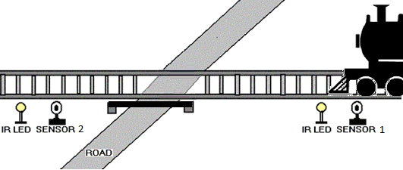
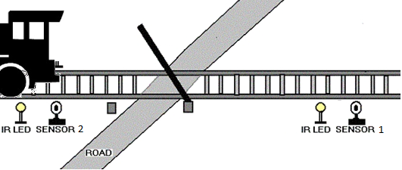
The gate remains closed as the train passes the crossing.
When the train crosses the gate and reaches second sensor, it detects the train and the microcontroller will open the gate.

Slide 9
ADVANTAGES :
Automatic railway gates offer several advantages, including:
Safety: Automatic gates enhance safety by reducing the likelihood of accidents at level crossings. They can quickly close when a train approaches, preventing vehicles or pedestrians from crossing the tracks.
2. Efficiency: These gates streamline traffic flow by minimizing road closures. They close only when a train is approaching, allowing vehicles to cross when the tracks are clear.
3. Reduced Human Error: Automation eliminates the possibility of human error in manually operating railway gates, reducing the chances of accidents caused by gatekeepers forgetting to close the gates.

Slide 10
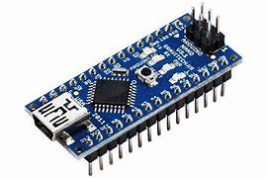
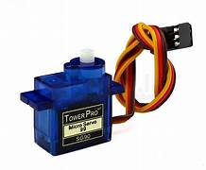
HARDWARE COMPONENTS :
ARDUINO NANO: Arduino Nano is a small, complete, flexible and breadboard-friendly Microcontroller board, based on ATmega328p, developed by Arduino.cc in Italy in 2008 and contains 30 male I/O headers, configured in a DIP30 style. Arduino Nano Pinout contains 14 digital pins, 8 analog Pins, 2 Reset Pins & 6 Power Pins.
SG-90 SERVO MOTOR : SERVO MOTOR SG90 DATA SHEET Tiny and lightweight with high output power. Servo can rotate approximately 180 degrees (90 in each direction), and works just like the standard kinds but smaller. You can use any servo code, hardware or library to control these servos

Slide 11
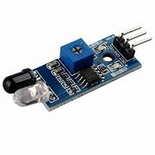
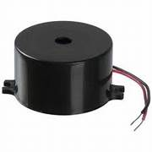
IR SENSOR MODULE : The IR sensor module consists mainly of the IR Transmitter and Receiver, Op-amp, Variable Resistor (Trimmer pot), output LED along with few resistors. IR LED emits light, in the range of Infrared frequency. IR light is invisible to us as its wavelength (700nm – 1mm) is much higher than the visible light range
BUZZER : The buzzer is an electrical device that is used to get a buzzing or beeping sound. The buzzing or beeping sound is created by vibrations developed in the diaphragm of the device. The buzzer circuit consists of a copper wire, nails, battery, an armature, and an electric buzzer.

Slide 12
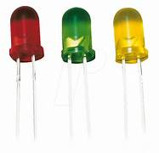
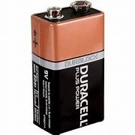
LED : LED stands for light-emitting diode, a semiconductor device that emits infrared or visible light when charged with an electric curren
9V- BATTERY : The nine-volt battery, or 9-volt battery, is an electric battery that supplies a nominal voltage of 9 volts

Slide 13
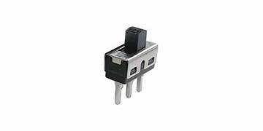
TOGGLE OR SLIDE SWITCH : An electrical switch that activates by a moving lever or a handle forward and backward to open or close an electrical switch is known as a toggle switch. These switches are also called toggle power switches or joystick switches. These switches are versatile devices, so they can be utilized with any electrical application.

Slide 14
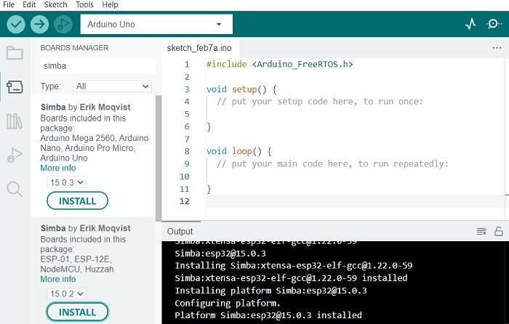

SOFTWARE COMPONENTS :
Arduino Software

Slide 15
LITERATURE SURVEY :
SNO | PROBLEM STATEMENT | EXISTING SYSTEM | DRAWBACKS
1 | the occurrence of train accidents on Indian railways due to obstacles on the tracks, including animals and landslides. | The existing system, as implied in the paper, lacks an automated and comprehensive approach to prevent train accidents caused by obstacles. Traditional methods may not effectively address issues such as animal deaths and landslides on railway tracks | The paper briefly mentions issues related to environmental factors, such as sunlight affecting the performance of the PIR sensor
2 | The railway sector faces a growing risk of accidents due to increased train traffic density. The need to enhance safety measures and prevent accidents, collisions, and fire incidents in the railway network is a critical challenge. | The existing system proposes an "Advanced Railway Accident Prevention System" utilizing IR sensors, ZigBee, and microcontrollers. It integrates features such as automatic speed control, collision detection, fire detection, detaching couches during fire incidents, automatic railway gate control, and track continuity checks. | The ZigBee communication has a limited range of about 50 meters, potentially limiting its effectiveness in remote station communication.
3 | The paper aims to address this issue by developing an Accident Prevention System for railway tracks. The specific problem involves detecting obstacles, such as crowds, animals, or vehicles, on the tracks, providing alerts to prevent accidents | The existing system relies on deep learning techniques, specifically TensorFlow Lite, for object recognition using images captured by a camera. It uses a Raspberry Pi for overall processing and includes a display and voice module for alerting the loco-pilot. | The paper does not explicitly discuss the scalability of the proposed system, especially in the context of a widespread railway network
4 | Railway accidents at unmanned crossings in India are a significant concern, often caused by people with headphones unaware of approaching trains. Existing systems fall short in preventing accidents caused by sudden train arrivals. There is a lack of a comprehensive solution that can detect trains in real time, especially in noisy environments, and alert individuals to avoid potential collisions. | The paper reviews several existing systems, including those using GSM/GPS, ultrasonic sensors, infrared sensors, and image processing. While these systems automate gate operations, they have limitations such as sensitivity to environmental changes, reliability issues, and the inability to effectively alert individuals about approaching trains in real time. | The proposed system relies on ultrasonic and infrared sensors, which are sensitive to environmental changes like temperature, dust, and rain, affecting system accuracy.

Slide 16
5 | The problem addressed in the paper is the need to enhance security in the rail transport sector, specifically focusing on preventing accidents and suicides on railway properties, including level crossings. The increasing speed of rail transport connecting densely populated areas emphasizes the importance of maintaining safety and reliability. | The paper discusses existing measures taken in various countries to address railway accidents and suicides. It acknowledges that responses cannot be universally applied due to cultural, sociological, and organizational differences between countries. The analysis includes statistics from the European Railway Agency's reports, emphasizing accidents involving unauthorized persons and suicides | The complexity of defining responsibility boundaries, especially at level crossings, is acknowledged. This complexity may hinder the implementation of effective preventative measures, particularly in cases where accidents involve human errors by road users.
6 | Railway accidents caused by obstacles on the track, smoke inside trains, and flooding pose significant risks, leading to derailment, collisions, injuries, and property damage. In the context of the Addis Ababa Light Rail Transit, the Ethiopian Railway Corporation faced monetary losses due to derailments caused by collisions with animals and block materials in certain areas. The need to mitigate these risks and enhance railway safety is the primary problem addressed in the paper. | The existing railway safety systems may lack comprehensive measures to detect and prevent obstacles, smoke, and flooding in real-time. Traditional systems might rely on manual intervention or have limited capabilities to address specific hazards. The paper proposes an Arduino-based safety system as an alternative to enhance the existing safety measures | Traditional safety systems may lack advanced sensors, limiting their ability to detect obstacles, smoke, or flooding with precision.
7 | Railway accidents remain a significant concern despite existing safety measures, leading the authors to propose a Railway Accident Monitoring system. The primary challenges include the persistence of accidents, with at least one major incident recorded annually, highlighting the need for enhanced safety measures in the vast Indian railway network. The key issues identified are derailments, anti-collision, wheel imbalances, level crossings, and tunnel accidents | The paper refers to the existing system as employing safety measures such as GPS for tracking trains and avoiding collisions. However, it indicates limitations in the current system, citing unmanned railway crossings as accident-prone areas, improper lighting in tunnels due to communication and power supply issues, and the potential failure of the GPS-based anti-collision system. | The paper does not provide a direct comparison with existing railway safety systems or alternative solutions, making it unclear how the proposed module improves upon or differs from current practices.
8 | The primary concern addressed by the paper is the safety of railway transportation, emphasizing the increasing frequency of train accidents leading to fatalities. The paper identifies collisions as a major issue, necessitating the development of an anti-collision system to enhance railway safety. | The existing railway transport system is characterized by a rising number of accidents, particularly derailments and track crack issues. Detection of cracks in railway tracks poses a significant challenge, and the paper notes that the current approach involves diverting trains to parallel tracks when a crack is detected. However, this method may still pose risks if another train approaches from the opposite direction. | The existing systems face difficulties in detecting cracks efficiently, and the paper suggests that high-cost solutions, such as image processing, have limitations.

Slide 17
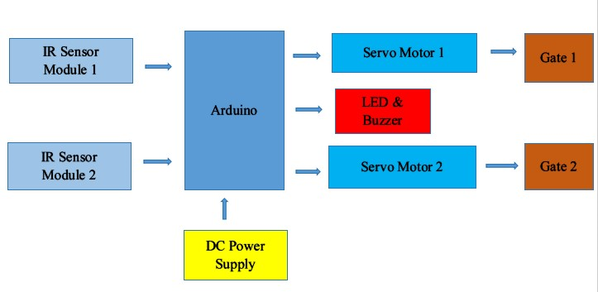
BLOCK DIAGRAM :

Slide 18
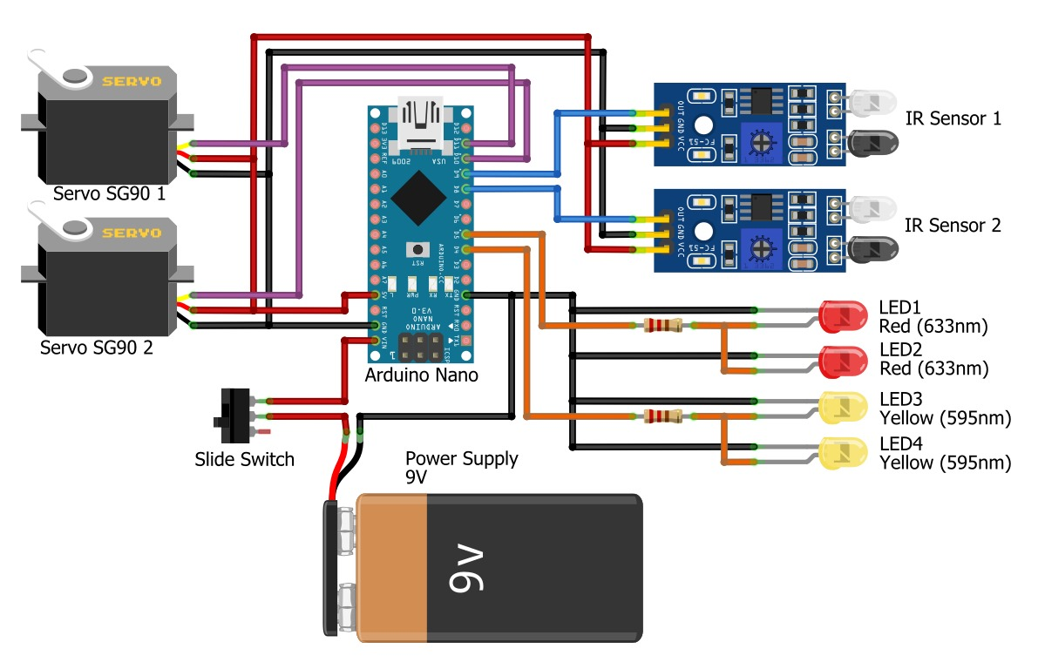
SYSTEM ARCHITECTURE :

Slide 19
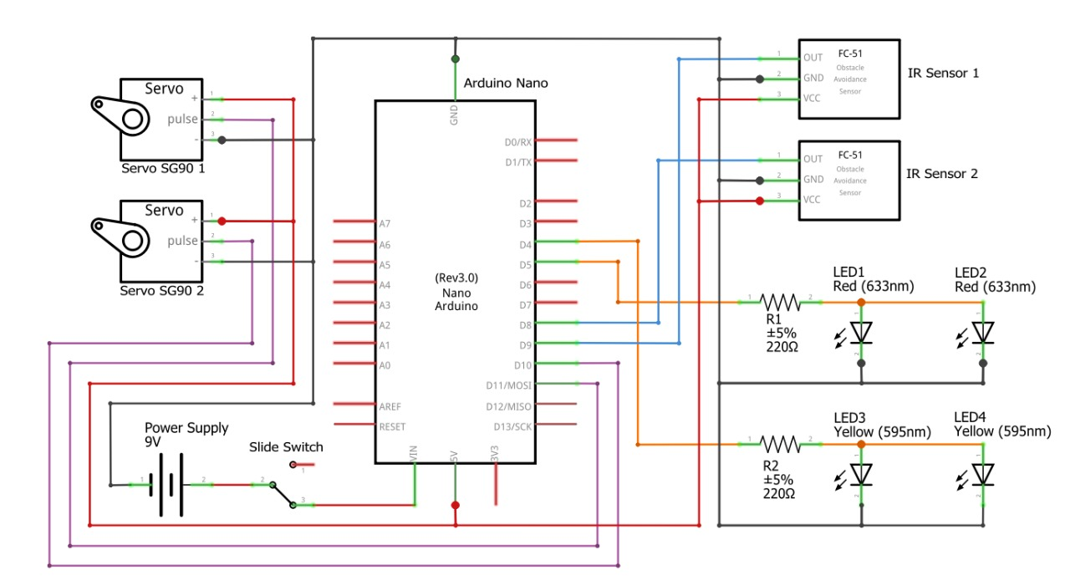
CIRCUIT DAIGRAM:

Slide 20
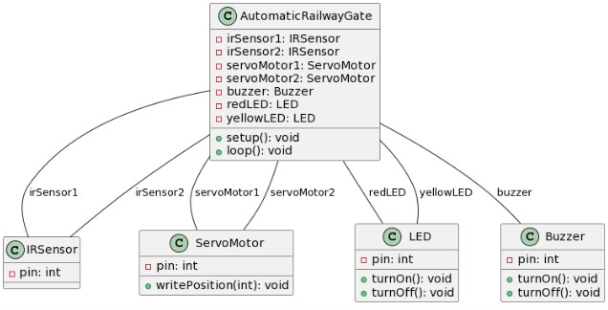
UML diagrams
CLASS DIGARAM

Slide 21
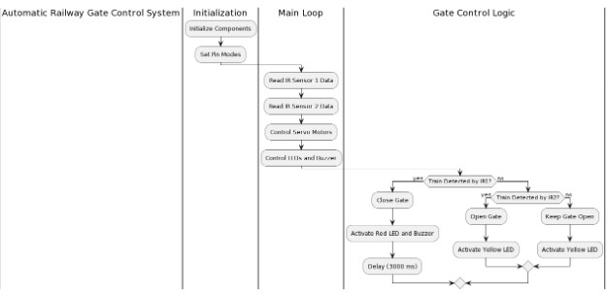
ACTIVITY DIAGRAM :

Slide 22
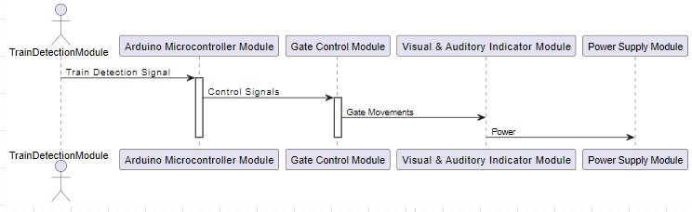
SEQUENCE DIAGRAM

Slide 23
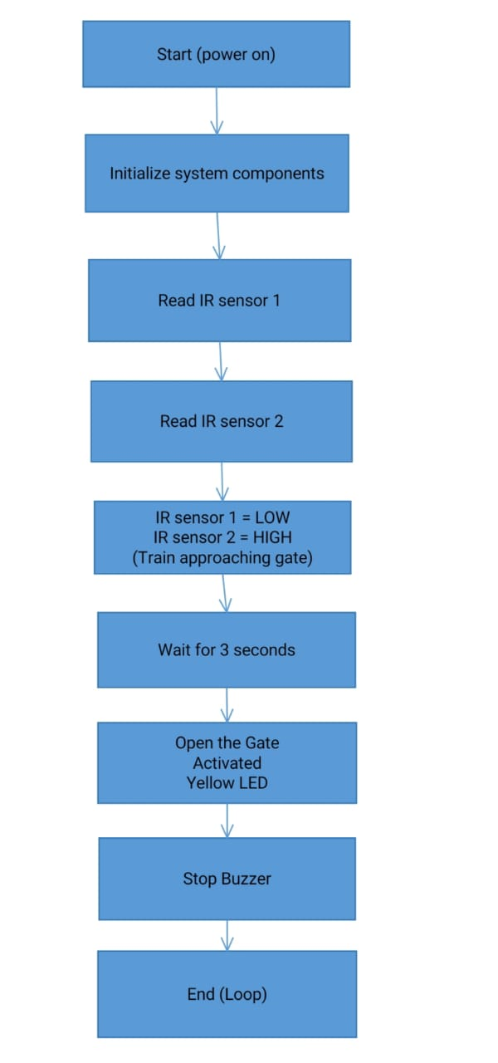
FLOW CHART :

Slide 24
CONCLUSION :
The integration of Infrared (IR) and rain sensors in train accident prevention systems presents a robust and effective solution to enhance railway safety during adverse weather conditions.
By combining these technologies, railways can significantly reduce the risk of accidents and ensure smoother operations.
The Infrared sensors excel in detecting obstacles on the tracks, irrespective of weather conditions, allowing for timely alerts to train operators and appropriate braking actions.

Slide 25
FUTURE ENHANCEMENT :
To enhance automatic railway gates using IR sensors in the future, you could consider implementing the following:
Smart Predictive System: Integrate machine learning algorithms to predict train arrival times based on historical data, allowing the system to preemptively close gates before the train arrives.
Advanced Obstacle Detection: Enhance IR sensors with advanced obstacle detection technologies, such as computer vision, to accurately identify objects on the tracks and differentiate between trains, vehicles, and pedestrians.

Slide 26


